Slide 1
Multi-class classification of psychiatric disorders based on EEG-derived features
Gia-Huy Hoang
Ishika Ghosh
Saptadwipa Mitra
Notes:
Multi-class classification of psychiatric disorders based on EEG-derived features, this topic explores the application of machine learning techniques to categorize individuals into various psychiatric disorder categories using data from electroencephalography (EEG). By leveraging EEG-derived features such as power spectral density and functional connectivity, this approach aims to provide insights into the underlying neural mechanisms of psychiatric disorders and enhance diagnostic accuracy for personalized treatment strategies.

Slide 2
Motivation: Cost-Effective and Non-Invasive Diagnostic Modality
Diagnosis of psychiatric disorders rely on self-reported symptoms, hindering early intervention. Brain changes precede symptoms, allowing early diagnosis with biomarkers.
EEG, a non-invasive and cost-effective neuroimaging tool, is ideal for mental health diagnostics. Machine learning enhances diagnostic accuracy while ensuring accessibility and affordability for widespread clinical use.
Notes:
Psychiatric disorders pose significant challenges for diagnosis and treatment due to their complex and heterogeneous nature. Traditional diagnostic methods often rely on subjective assessments and self-reported symptoms, leading to delays in intervention and suboptimal outcomes.
Recent advancements in neuroscience and machine learning offer promising avenues for improving psychiatric disorder diagnosis. By leveraging EEG-derived features, such as Power Spectrum Density (PSD) and Functional Connectivity (FC), we can extract valuable insights into the neural correlates of psychiatric disorders.
This motivation underscores the importance of utilizing EEG data and machine learning in psychiatric disorder diagnosis, aiming for early intervention and improved patient outcomes.

Slide 3

Research Question
Can machine learning models using EEG accurately classify psychiatric disorders and distinguish them from healthy controls(HC’s)?

Slide 4
Dataset
Patients with psychiatrist disorders: 850
Healthy Controls: 95
Total = 945
Demographic:
Age, Education Level, IQ Scores​
EEG Data:​
EEG Data: Quantitative EEG (QEEG) at resting-state assessments​
EEG Features: Power Spectrum Density (PSD), Functional Connectivity (FC)​
Notes:
Demographic:
Demographic features include age, education level, and IQ scores of the patients.
The dataset comprises 850 patients diagnosed with psychiatric disorders and 95 healthy controls, totaling 945 individuals.
EEG Data:
Quantitative EEG (QEEG) data collected during resting-state assessments.
EEG features include Power Spectrum Density (PSD) and Functional Connectivity (FC).
This information highlights the composition of the dataset, focusing on demographic characteristics and EEG data types, essential for understanding the patient population and the data collected for analysis.

Slide 5
Main Disorder
Specific Disorder
Addictive disorder, Trauma and stress related disorder, Mood disorder, Healthy control, Obsessive compulsive disorder, Schizophrenia, Anxiety disorder.
Alcohol use disorder, Acute stress disorder, Depressive disorder, Healthy control, Behavioral addiction disorder, Obsessive compulsive disorder, Schizophrenia, Panic disorder, Social anxiety disorder, Posttraumatic stress disorder, Adjustment disorder, Bipolar disorder.
Notes:
This section outlines the main and specific disorders present in the dataset:

Slide 6
Approach
Exploratory Data Analysis: to understand the data
Cleaning Up Data
Machine Learning with Multi classes classification: main disorder and specific disorder classification

Slide 7
Exploratory Data Analysis

Slide 8
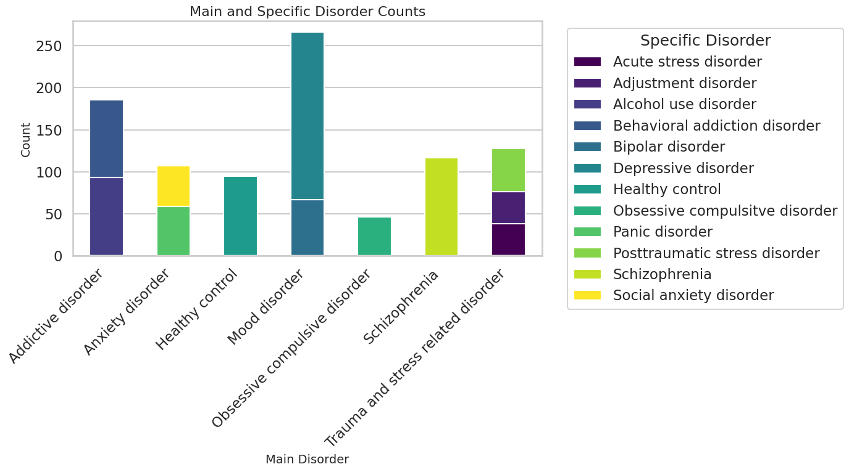
Diagnosis: Is there class disbalance?
In [9]
Notes:
Indeed, we do see class disbalances. The most noticeable are:
Obsessive compulsive disorder
Specific disorders in Trauma and stress related disorders and Anxiety disorders categories
Depressive disorder

Slide 9
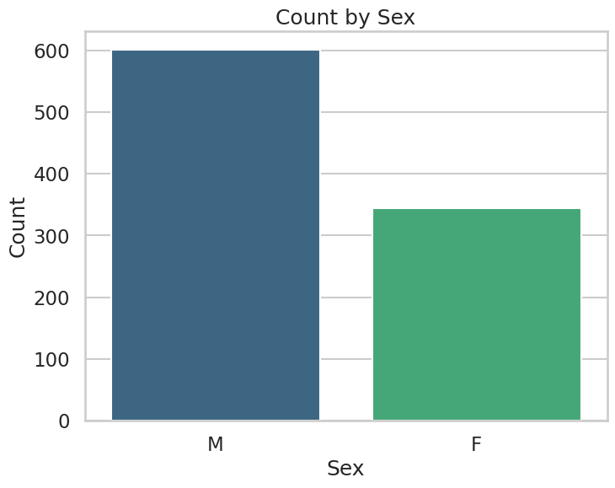
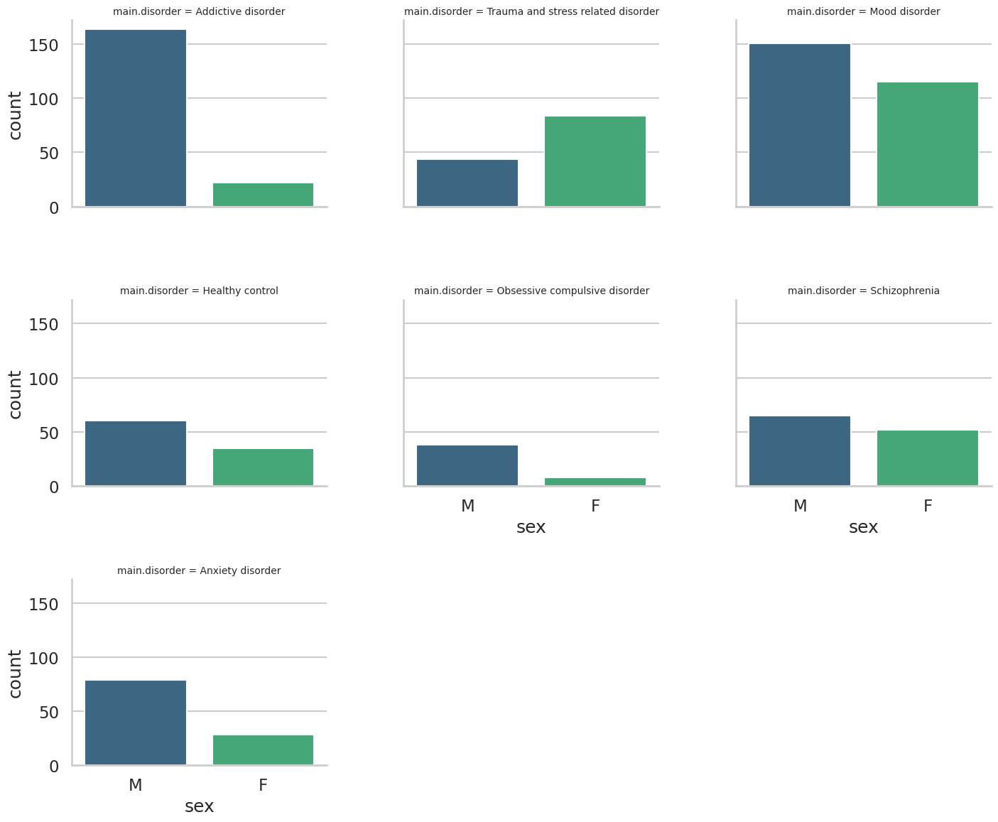
Sex differences
Notes:
Men is more in addictive disorder, and Female has more in mood disorder.

Slide 10
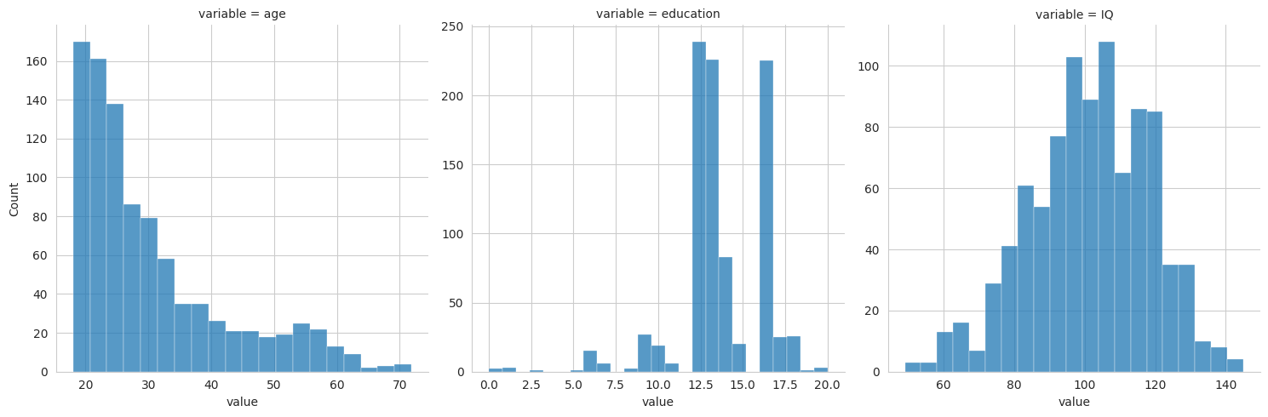
What distributions numeric variables have?
Notes:
The distribution appears to be approximately normal, which makes sense, no log-transform is needed

Slide 11
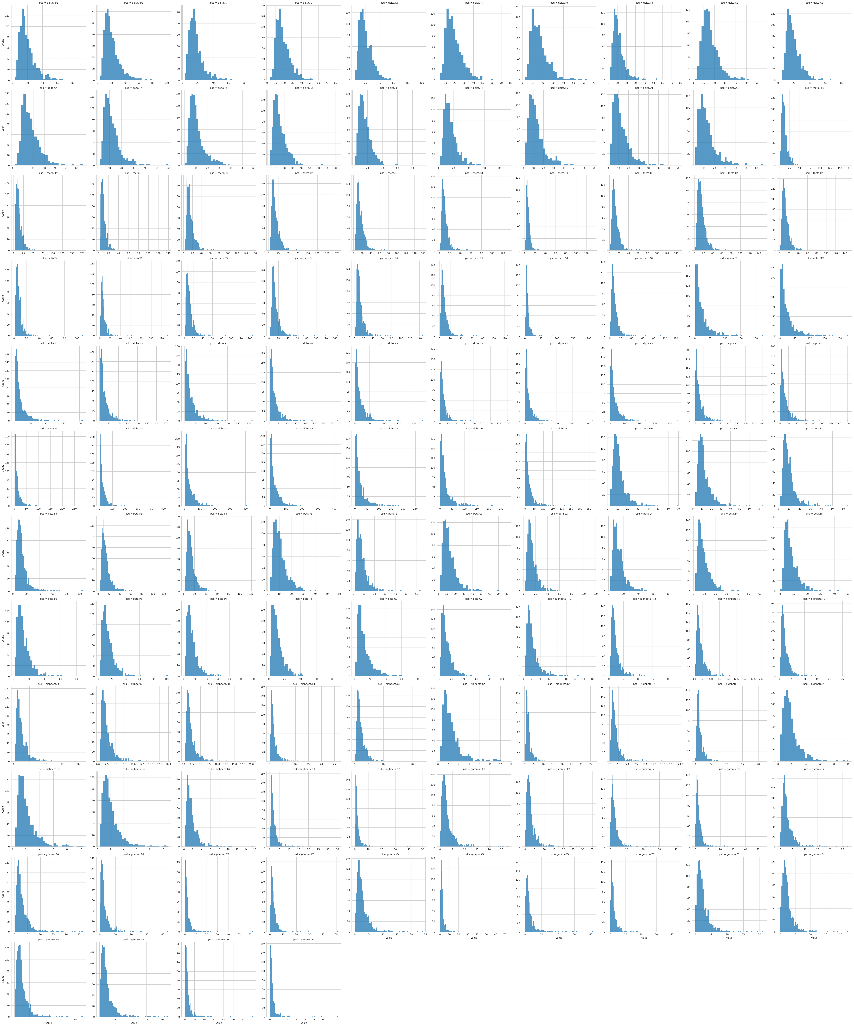

Power Spectral Density (PSD) and Functional Connectivity (FC) distribution
Log-like distribution => need to log-transform
PSD
FC
Notes:
However, when we looks to Power Spectrum Densitivity Distrubtion and Function Connectiity Distribution, it turns out be log-like distrubtion. So we performed the log-transformation for these EEG features in

Slide 12
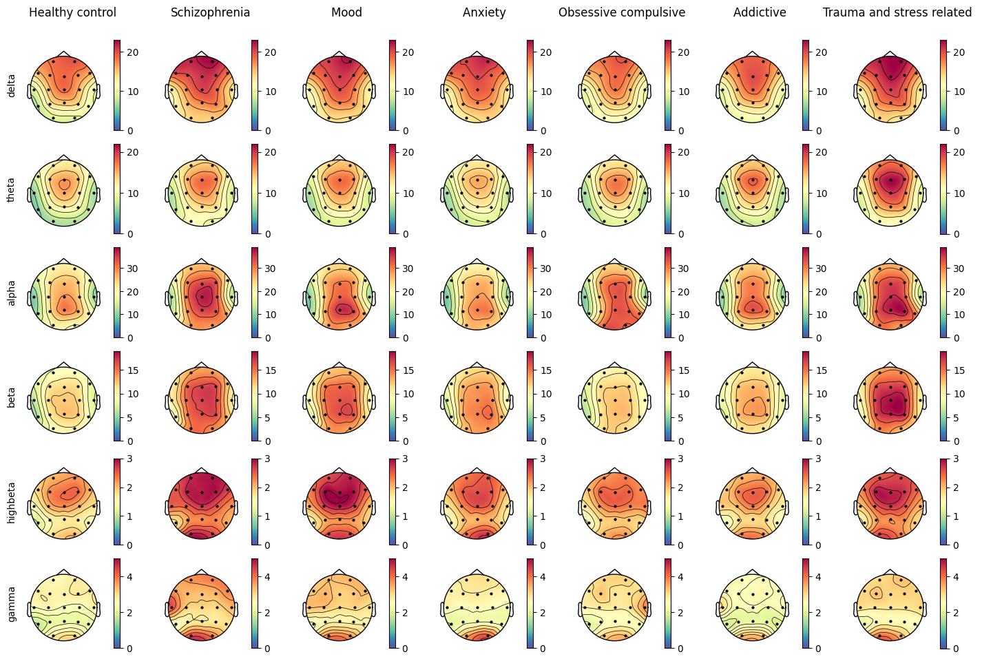
PSD topographic map

Slide 13
Machine Learning: Multi-class classification

Slide 14
Preprocessing
Drop meaningless columns: separation, no., eeg.date.
One-hot encoding categorical variables: sex, main.disorder, and specific.disorder.
Logarithmic Transformation: Apply logarithmic transformation to numeric columns, except education and IQ.
Split Data: Split into training (67%) and testing subsets (33%).
Scale Data: Standardize features in both subsets.
Notes:
These preprocessing steps aim to prepare the dataset for machine learning modeling by removing irrelevant columns, encoding categorical variables, transforming numeric features, and splitting the data for training and evaluation.

Slide 15
Machine Learning Model
Logistic Regression, ElasticNet
SVM, Linear Kernel
Random Forest
XGBoost
LightGBM
CatBoost
Notes:
In this analysis, we'll explore a variety of machine learning models for classification tasks. We'll start with Logistic Regression, utilizing ElasticNet regularization for feature selection. Next, we'll delve into Support Vector Machines with a linear kernel, followed by Random Forests, an ensemble method leveraging multiple decision trees. Moving on, we'll explore the boosting algorithms, including XGBoost known for its efficiency, LightGBM designed for speed, and CatBoost tailored for categorical features. Each model brings its unique strengths to the table, providing a comprehensive overview of classification techniques for our analysis.

Slide 16

Training and Model evaluation
Hyperparameter optimization: Perform Grid Search and 10-fold Cross-Validation to find the best hyperparameters for each ML model.
Evaluation: Evaluate each model for each disorder on precision, recall, and F1 score.
Notes:
Perform grid search with caching on multiple machine learning models to find the best hyperparameters and their performance metrics efficiently

Slide 17
Result

Slide 18
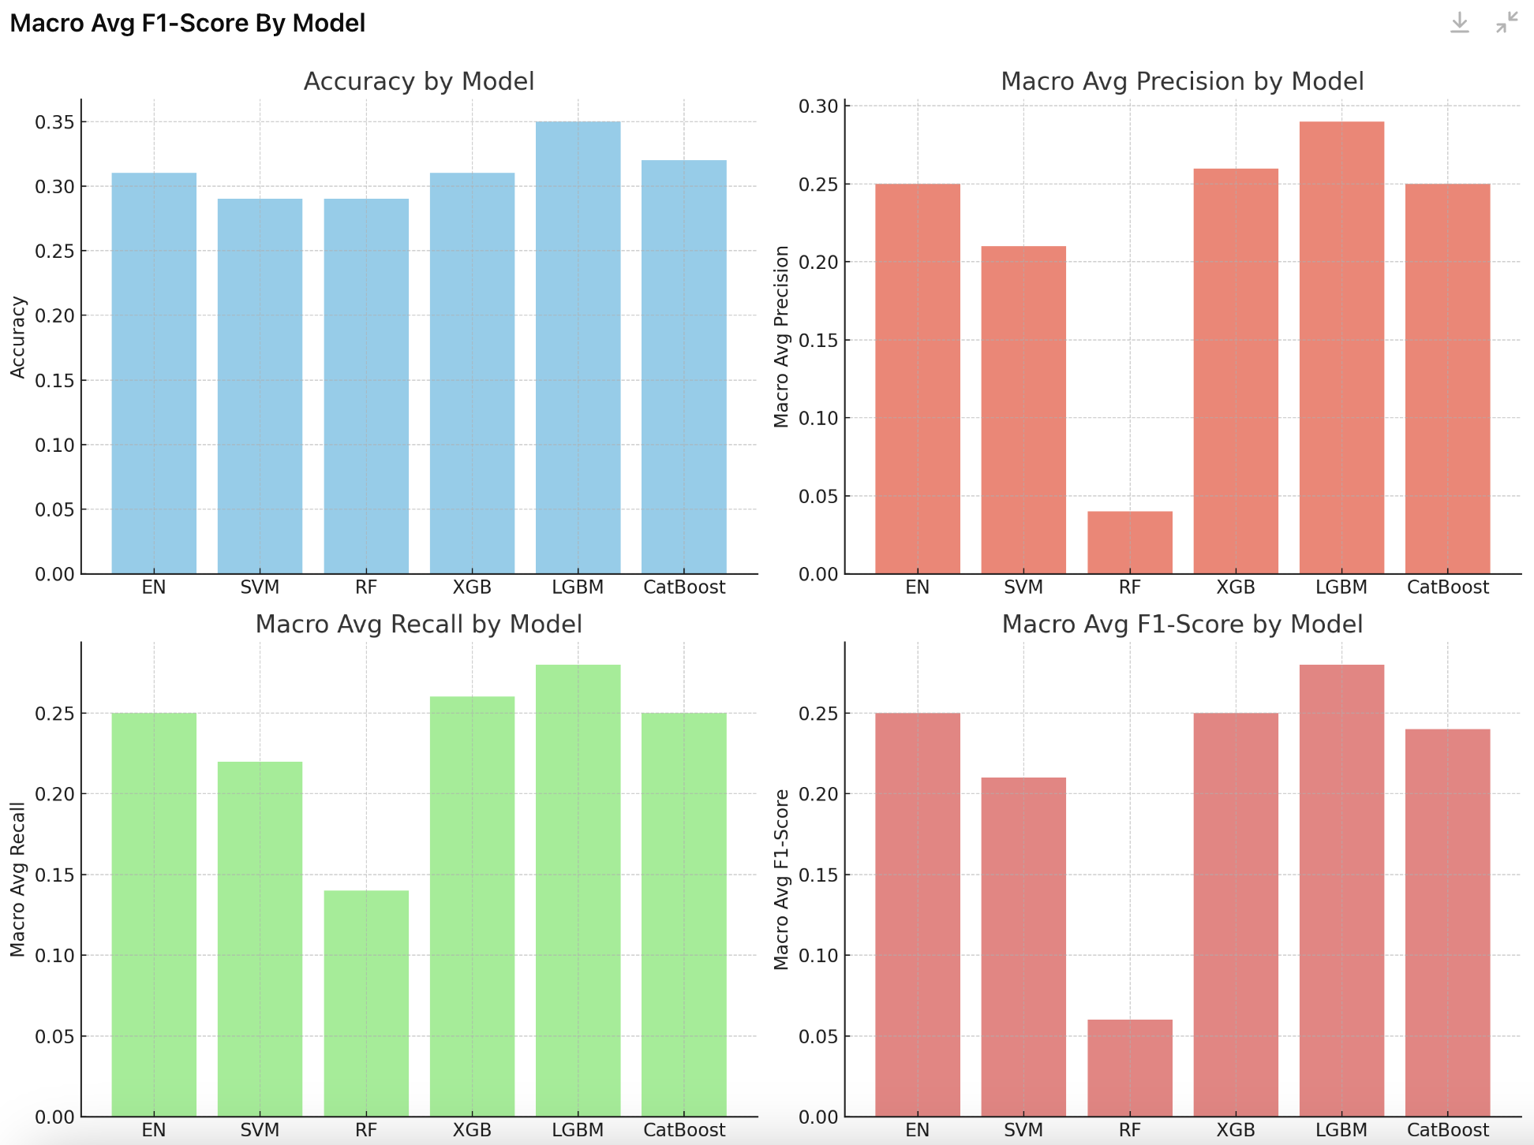
Main Disorders: Macro Avg F1-Score By Model

Slide 19
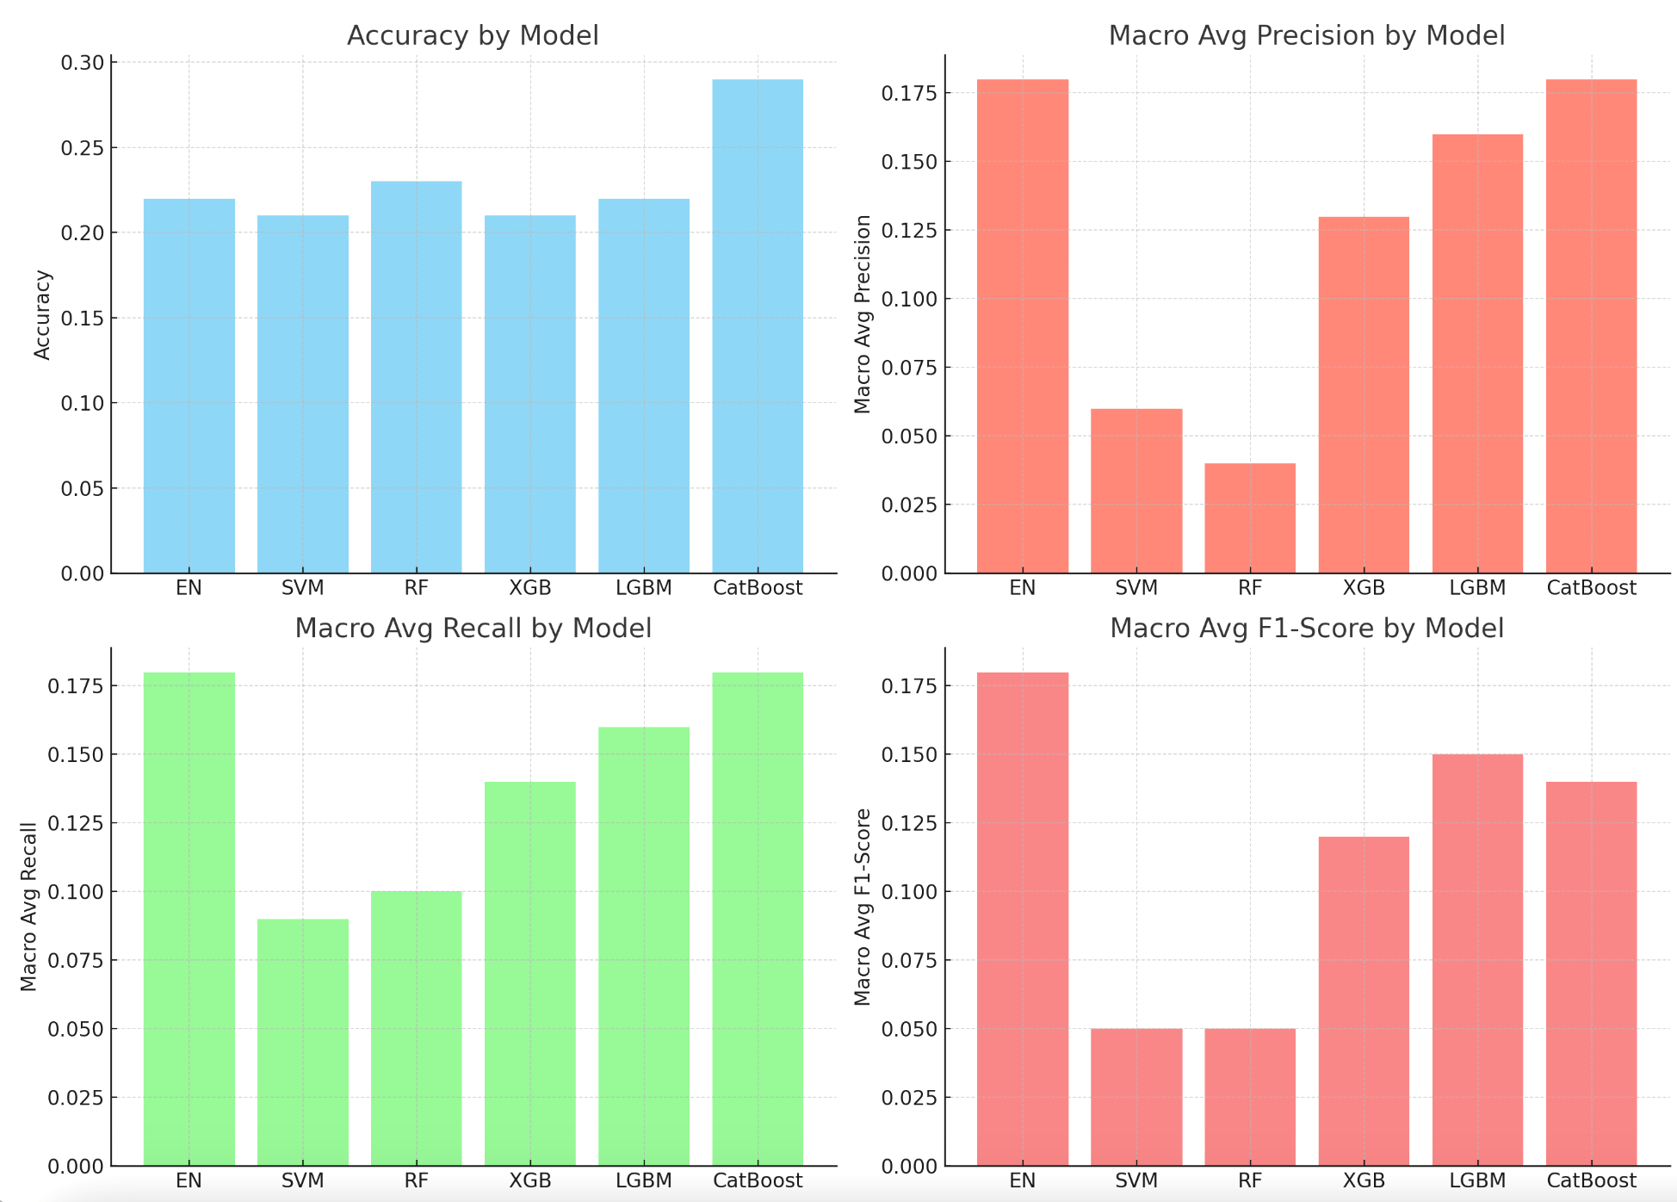
Specific Disorders: Macro Avg F1-Score By Model

Slide 20
Conclusion
The performance of machine learning models using EEG features to classify psychiatric disorders compared to healthy controls isn't great. This matches with other studies that show clinical models tend to do better than neural features.
Right now, the idea of ML accurately predicting psychiatric illnesses from EEG data is still far from being a reality.
Notes:
Machine learning models trained on EEG features struggle to effectively classify psychiatric disorders from healthy controls. This aligns with literature indicating that clinical models often outperform neural features. Looking ahead, the idea of using ML to predict psychiatric illnesses from EEG data remains a promising avenue for future research.
While existing machine learning models trained on EEG features demonstrate less-than-optimal performance in distinguishing psychiatric disorders from healthy controls, I'm intrigued by the prospect of refining these techniques for binary classification. By focusing on this future project, we aim to delve deeper into the intricacies of EEG-based classification, with the ultimate goal of enhancing diagnostic accuracy and contributing to advancements in mental health diagnostics and treatment.

Slide 21
Citations
https://www.frontiersin.org/journals/psychiatry/articles/10.3389/fpsyt.2021.707581/full

